Slide 1
Pt.1 General System Design

Slide 2
Pt.1.1 Plan A——Full STM32
供电模块
OpenMV
电机模块
STM32
传感器
IMU
超声波

Slide 3
Pt.1.2 Plan B——Raspberry Pi 4B + STM32
供电模块1
电机模块
STM32
超声波
供电模块2
树莓派4B
IMU
WIFI
相机
PC

Slide 4
Pt.1.3 Plan C——STM32 + Remote Computation
供电模块
超声波
电机模块
STM32
传感器
IMU
OpenMV
PC
WIFI

Slide 5
Pt.1 Summary
Current Plan: [Plan B]
供电模块1
电机模块
STM32
超声波
供电模块2
树莓派4B
IMU
WIFI
相机
PC

Slide 6
Pt.2 Specific Module Design (Plan A)
(Note that the difference between Plan B and Plan A can be nearly ignored, hence modification will be completed in the electrical system schematics)

Slide 7
Pt.2.1 Sensor Module
供电模块
OpenMV
电机模块
STM32
传感器
IMU
超声波

Slide 8
Pt.2.1 Sensor Module
供电模块
OpenMV
电机模块
STM32
传感器
IMU
超声波
Module | Communication | Power | Model | Amount
OpenMV | GPIO x2 | 5V | / | 1
IMU | I2C x2 | 3.3-5V | / | 1
ultrasonic | GPIO x2 | 5V | HC-SR04 | 2

Slide 9
Pt.2.1 Sensor Module
OpenMV
GPIO
STM32
IMU
供电模块
超声波

Slide 10
Pt.2.2 Motor Module
供电模块
OpenMV
电机模块
STM32
传感器
IMU
超声波

Slide 11
Pt.2.2 Motor Module
供电模块
OpenMV
电机模块
STM32
传感器
IMU
超声波
TODO：刷子转速确定与对应电机选型细化
Module | Control | Power | Model | Amount
DC motor (wheel) | GPIO x5 | 12V | / | 2
DC motor (gripper) | GPIO x5 | 12V | / | 1
servo motor | GPIO x1 | 5V | / | 1

Slide 12
Pt.2.2 Motor Module
STM32
供电模块
GPIO (PWM+IO)
电机模块
电机驱动板
12V

Slide 13
Pt.2.3 Power Module
供电模块
OpenMV
电机模块
STM32
传感器
IMU
超声波

Slide 14
Pt.2.3 Power Module
供电模块
OpenMV
电机模块
STM32
传感器
IMU
超声波
Module | Power Input | Power Output | Model | Amount
Li-ion battery | / | 12V (output) | / | 1
power module | 12V | 1.25V + 3.3V + 5V (x5) | / | 1
motor driver board | 12V + 3.3V / 5V | / | / | 1

Slide 15
Pt.2.3 Power Module
舵机
5V
供电模块
3.3V + 5V
STM32 + 传感器
12V
锂电池
12V
电机驱动板

Slide 16
Pt.2 Specific Module Design (Plan A)
(Note that the difference between Plan B and Plan A can be nearly ignored, hence modification will be completed in the electrical system schematics)

Slide 17
Pt.2.1 Sensor Module
供电模块
OpenMV
电机模块
STM32
传感器
IMU
超声波

Slide 18
Pt.2.1 Sensor Module
供电模块
OpenMV
电机模块
STM32
传感器
IMU
超声波
Module | Communication | Power | Model | Amount
OpenMV | GPIO x2 | 5V | / | 1
IMU | I2C x2 | 3.3-5V | / | 1
ultrasonic | GPIO x2 | 5V | HC-SR04 | 2

Slide 19
Pt.2.1 Sensor Module
OpenMV
GPIO
STM32
IMU
供电模块
超声波

Slide 20
Pt.2.2 Motor Module
供电模块
OpenMV
电机模块
STM32
传感器
IMU
超声波

Slide 21
Pt.2.2 Motor Module
供电模块
OpenMV
电机模块
STM32
传感器
IMU
超声波
TODO：刷子转速确定与对应电机选型细化
Module | Control | Power | Model | Amount
DC motor (wheel) | GPIO x5 | 12V | / | 2
DC motor (gripper) | GPIO x5 | 12V | / | 1
servo motor | GPIO x1 | 5V | / | 1

Slide 22
Pt.2.2 Motor Module
STM32
供电模块
GPIO (PWM+IO)
电机模块
电机驱动板
12V

Slide 23
Pt.2.3 Power Module
供电模块
OpenMV
电机模块
STM32
传感器
IMU
超声波

Slide 24
Pt.2.3 Power Module
供电模块
OpenMV
电机模块
STM32
传感器
IMU
超声波
Module | Power Input | Power Output | Model | Amount
Li-ion battery | / | 12V (output) | / | 1
power module | 12V | 1.25V + 3.3V + 5V (x5) | / | 1
motor driver board | 12V + 3.3V / 5V | / | / | 1

Slide 25
Pt.2.3 Power Module
舵机
5V
供电模块
3.3V + 5V
STM32 + 传感器
12V
锂电池
12V
电机驱动板

Slide 26
Appendix

Slide 27
A.1 Technical Norms

Slide 28
A.1.1 3D-model Coloring Norms
Material | Color
PVC | White (Default)
TPU95 | Blue
TPU85 | Green
motor | Red
PLA | Orange
electronics | (Original)

Slide 29
A.1.2 Schematic Norms
Line Type | Color | Width
Normal (e.g. Communication) | Black (Default) | 0.75
GND | Grey | 1
VCC | Red | 1
Negative Electrode | Grey | 1
PWM | Green | 1
Encoder Feedback | Blue | 1

Slide 30
A.2 Documentations of Electronic Components

Slide 31
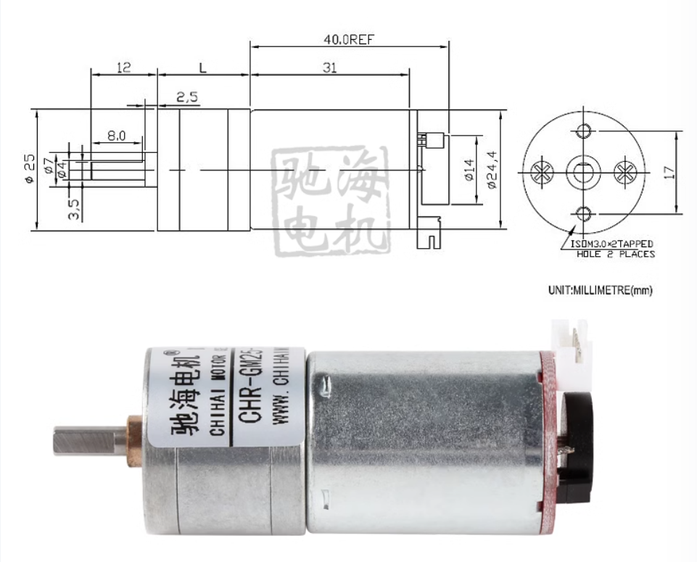
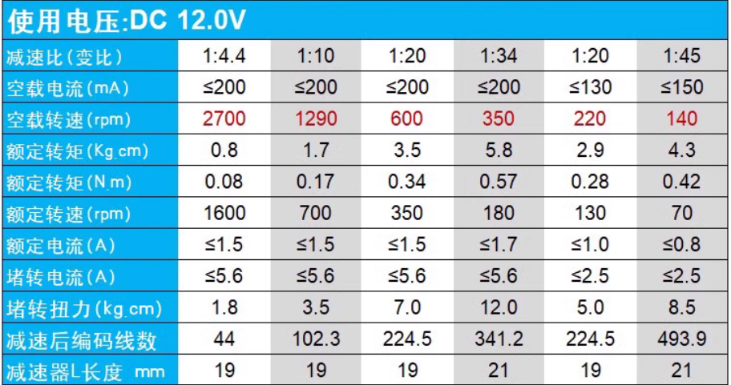
A.2.1 DC Motor
型号：25GA370
电压：12V
减速比：1：34 (350转)
质量：≈100g
淘宝链接1
淘宝链接2（Official）

Slide 32
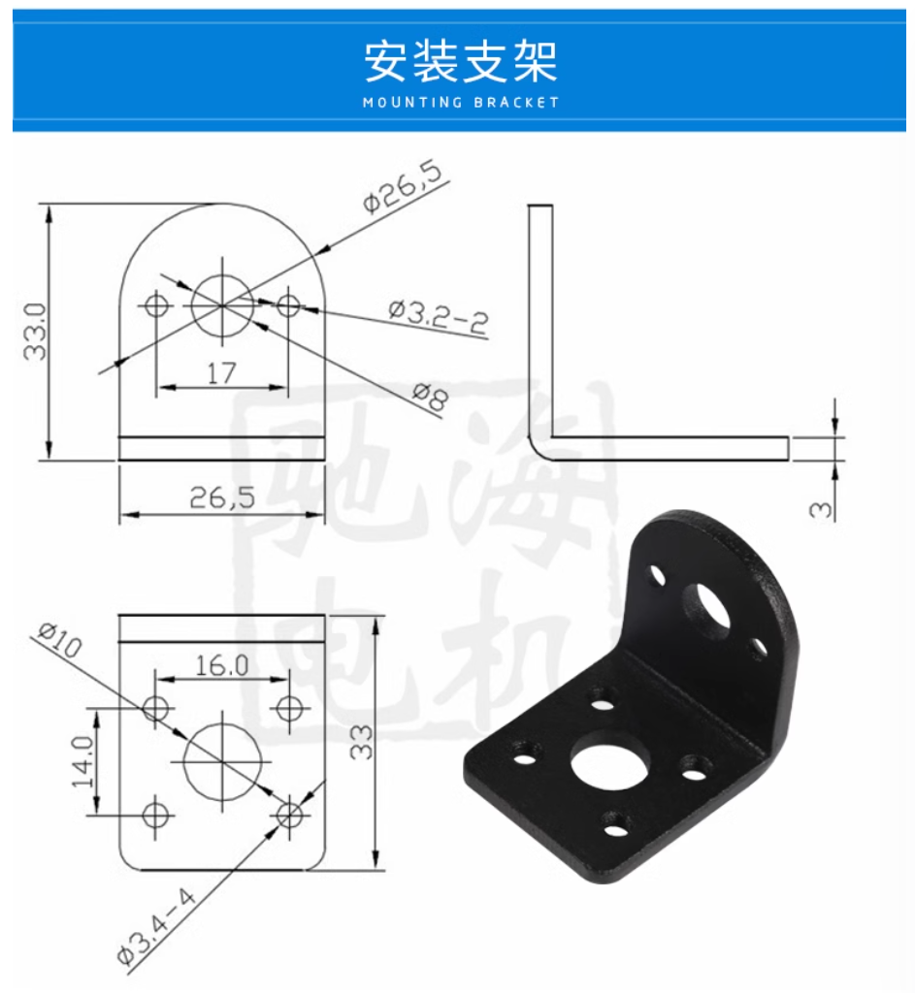
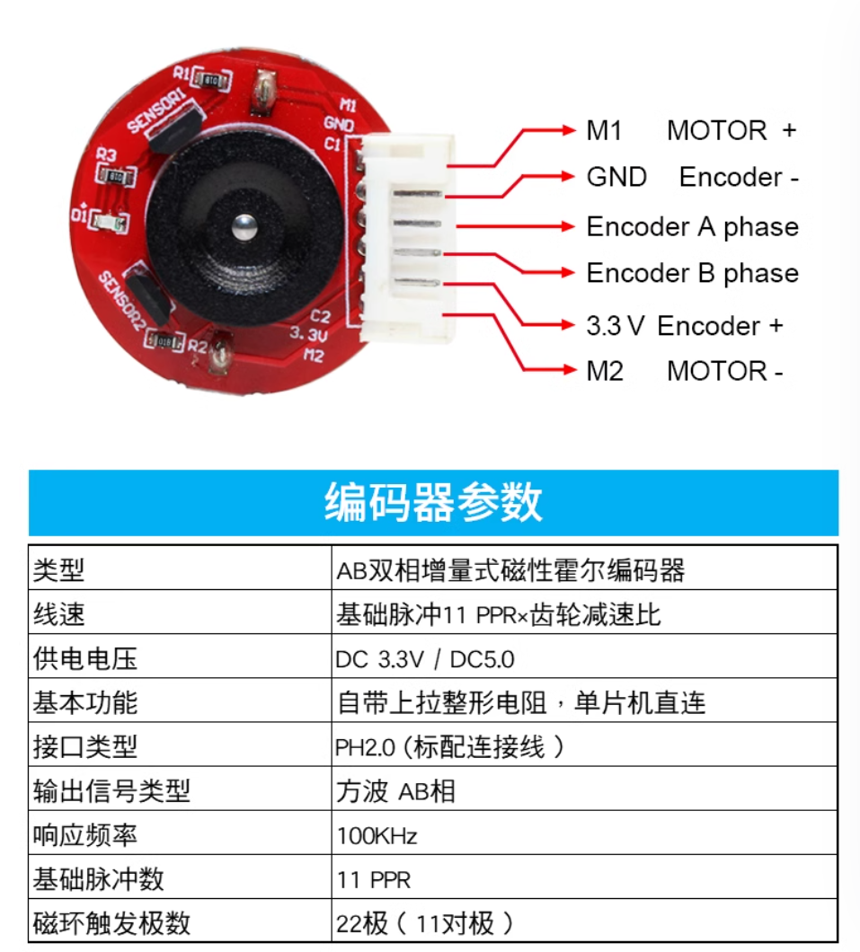
A.2.1 DC Motor

Slide 33
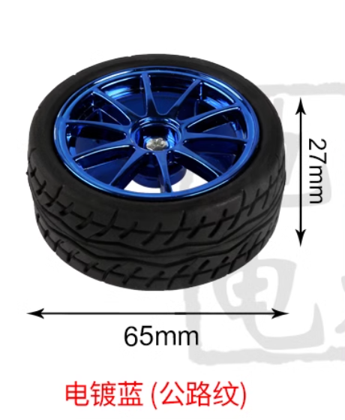
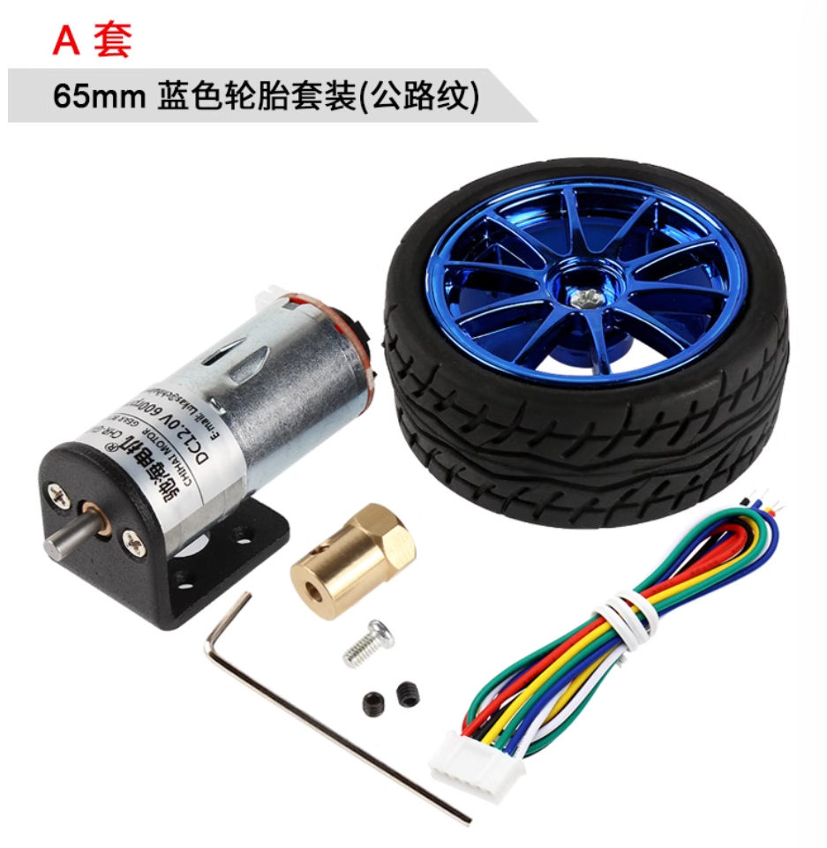
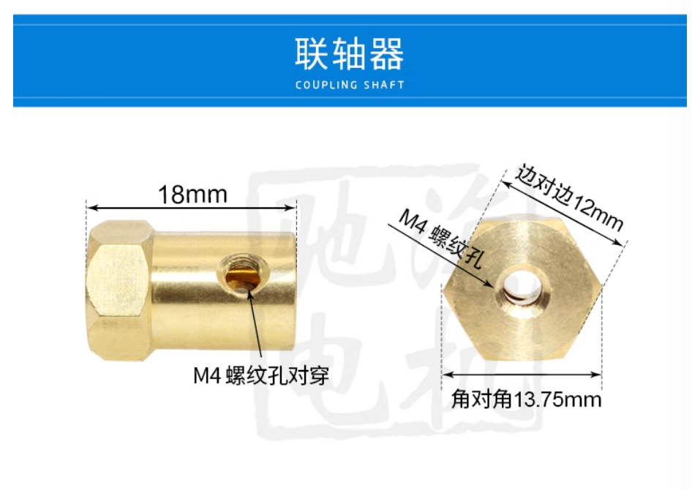
A.2.1 DC Motor

Slide 34
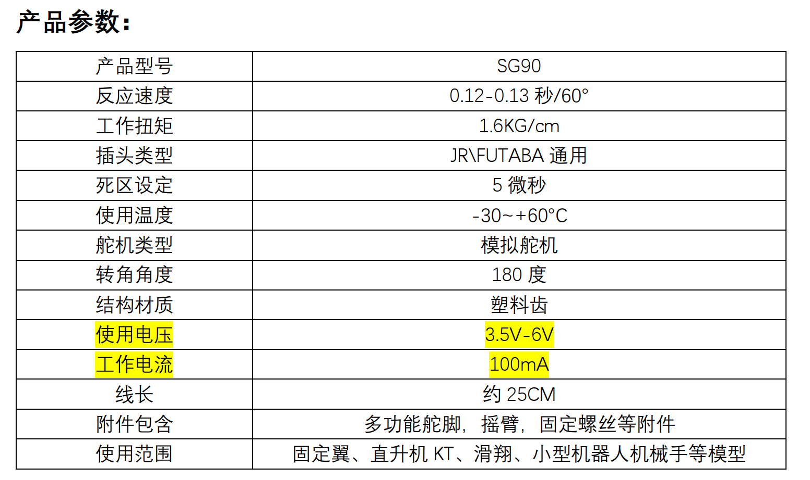
A.2.2.1 Servo Motor I
型号：SG90
电压：3.5-6V (常用5V)
转角角度：180度
质量：9g
淘宝链接

Slide 35
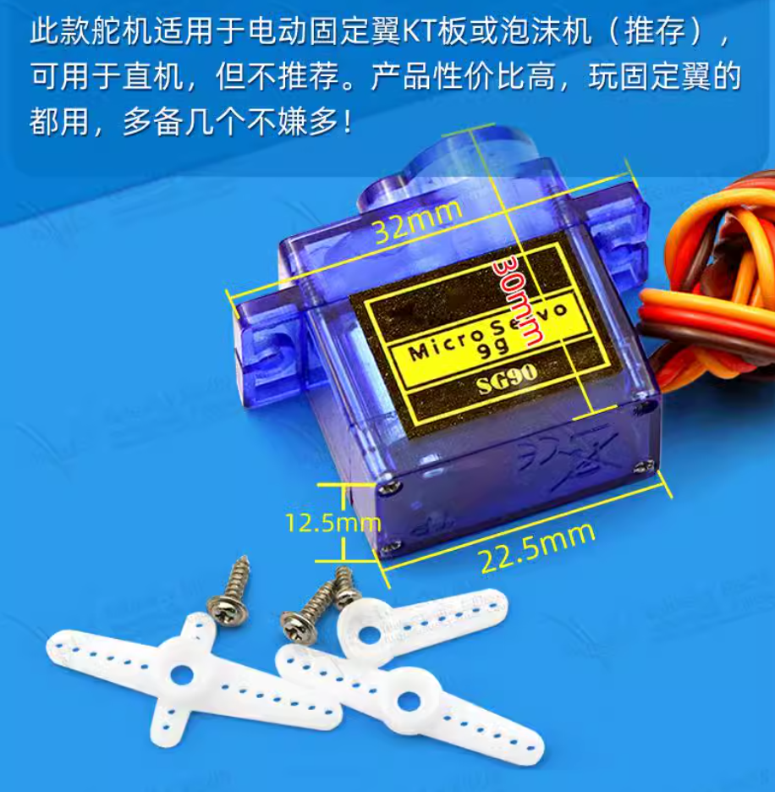
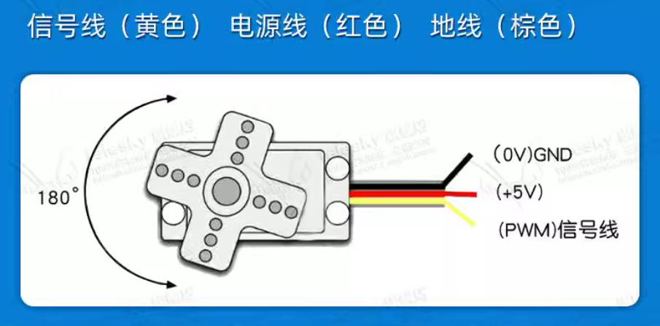
A.2.2.1 Servo Motor I

Slide 36
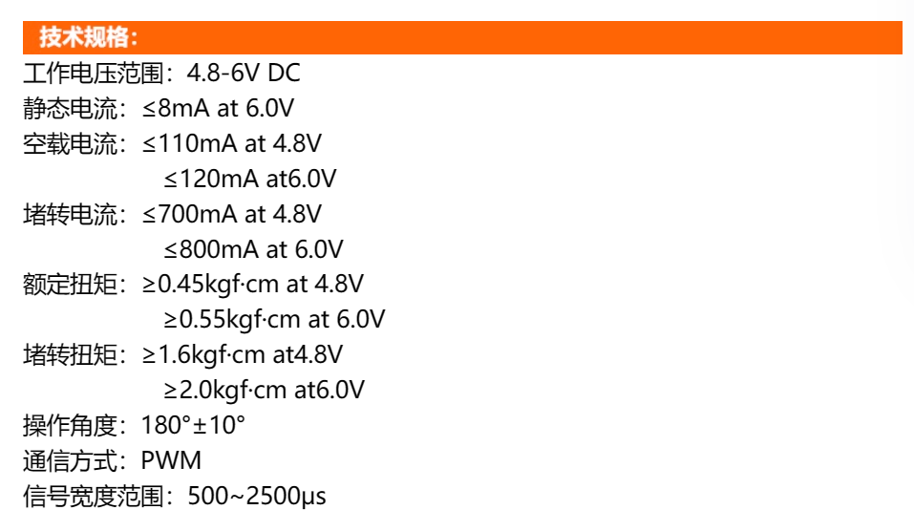
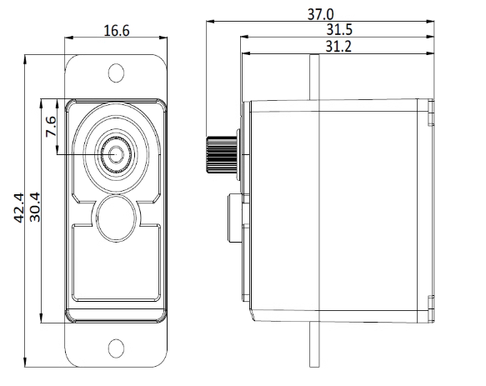
A.2.2.2 Servo Motor II
型号：SER0050
电压：4.8-6V (常用5V)
转角角度：180度
淘宝链接

Slide 37
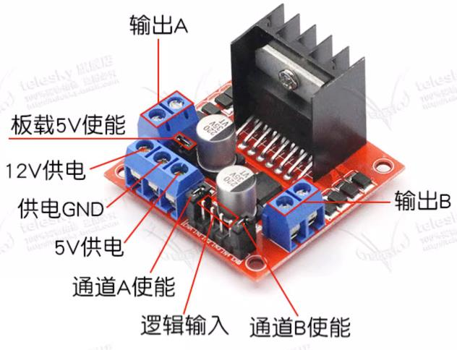
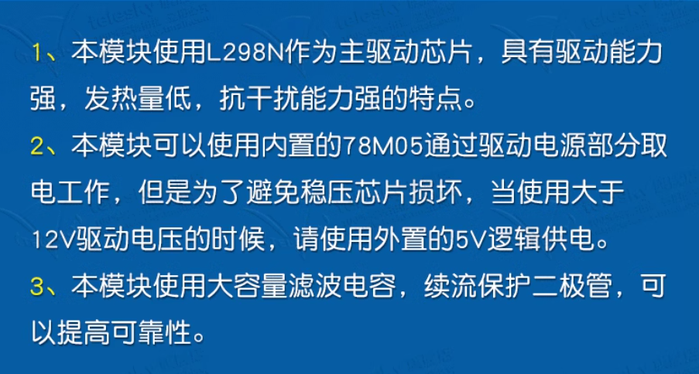
A.2.3 DC Motor Driver Board
型号：L298N
电压：12V & 5V
淘宝链接

Slide 38
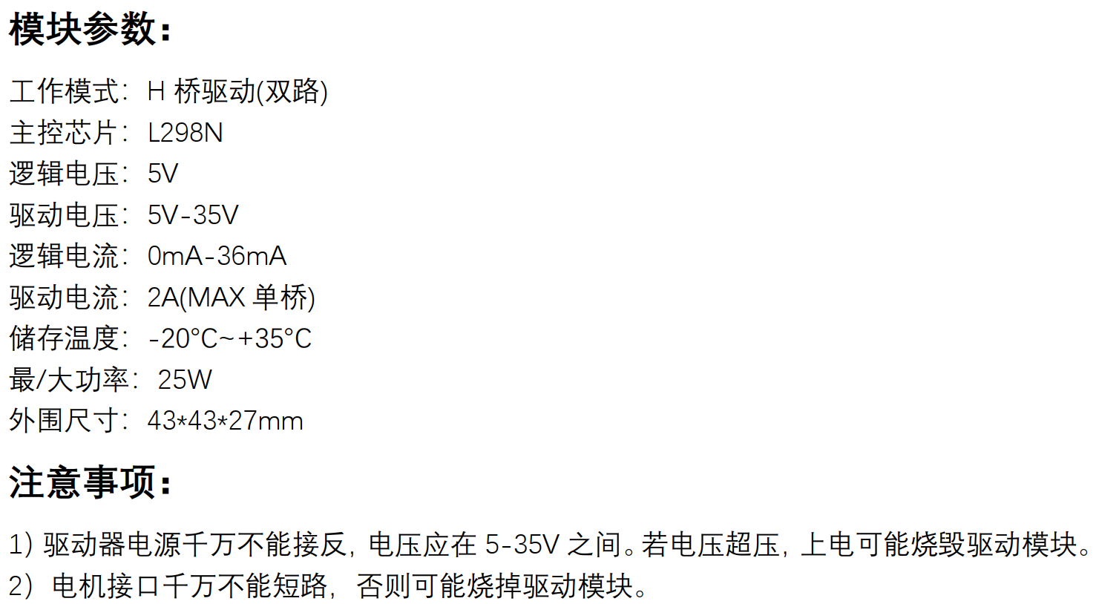
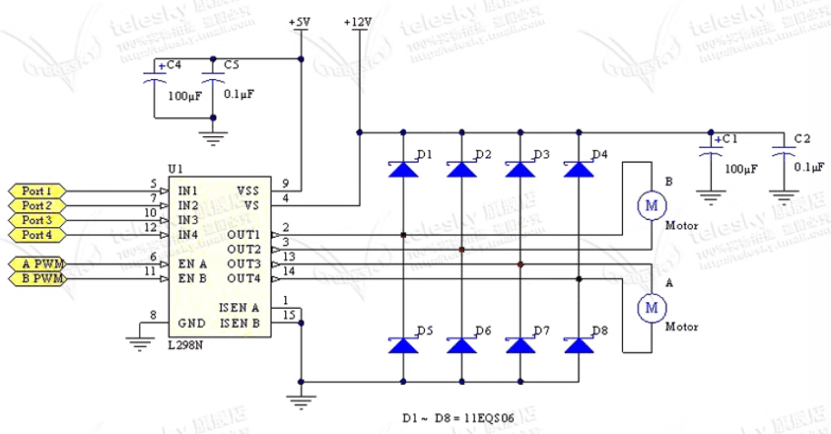
A.2.3 DC Motor Driver Board

Slide 39
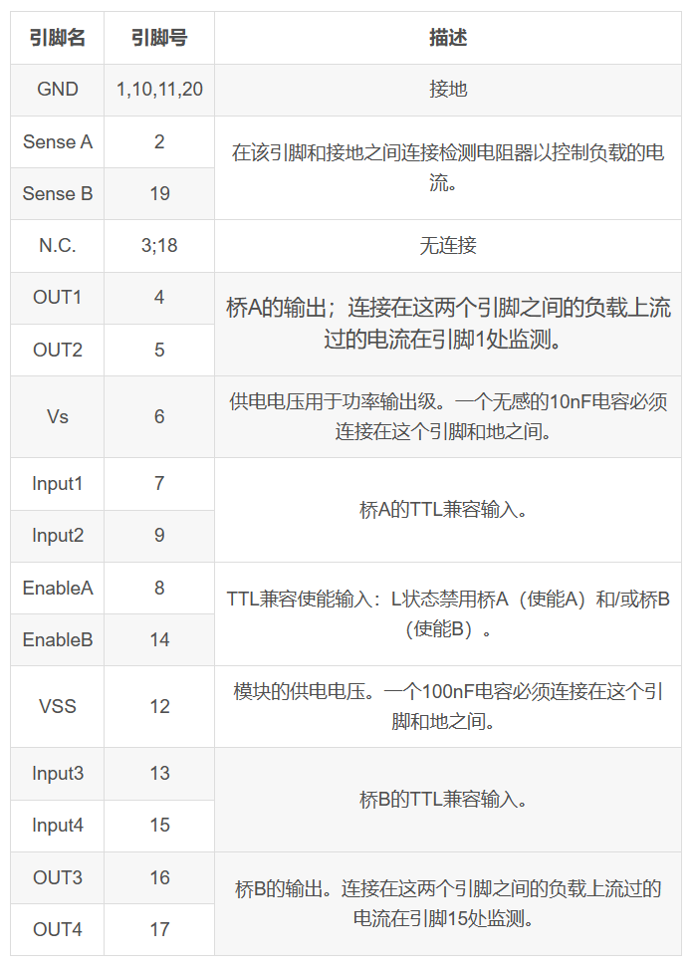
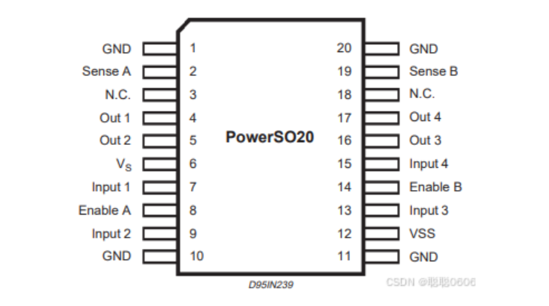
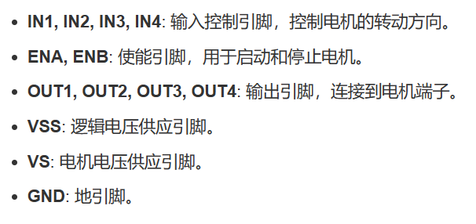
A.2.3 DC Motor Driver Board

Slide 40
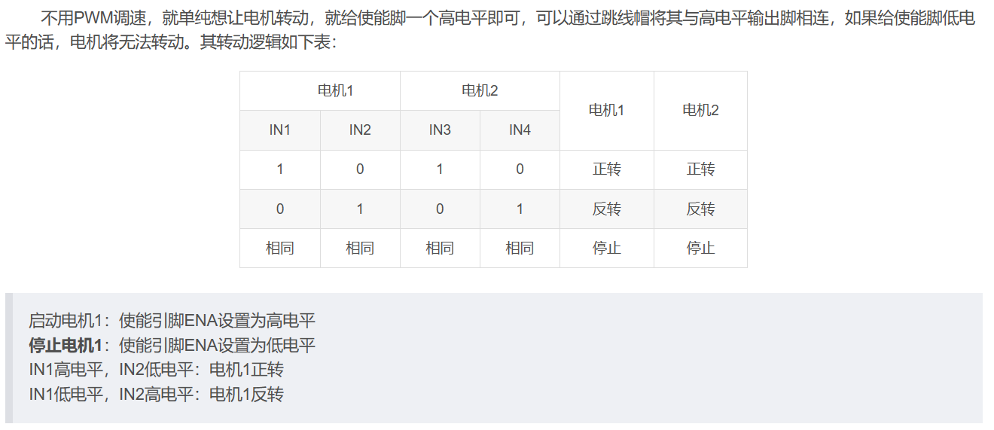
A.2.3 DC Motor Driver Board

Slide 41
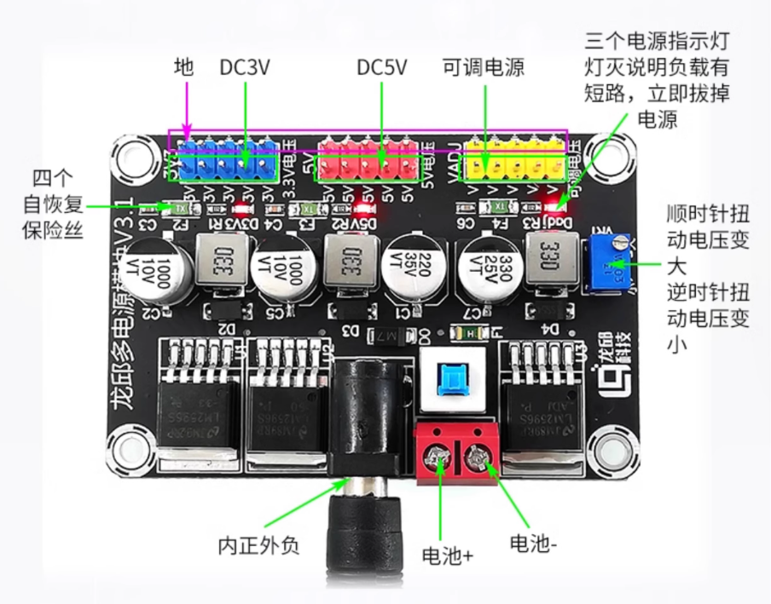
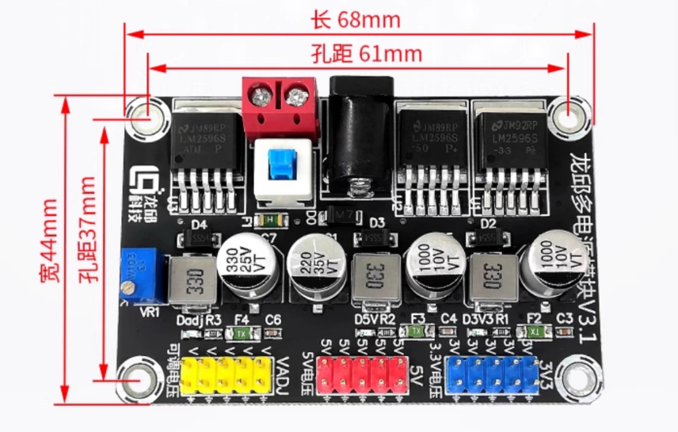
A.2.4 Power Module
型号：LM2596
输入电压：DC 6~25V
输出电压：DC 3.3V，5V，1.25V (每种 x5)
淘宝链接

Slide 42

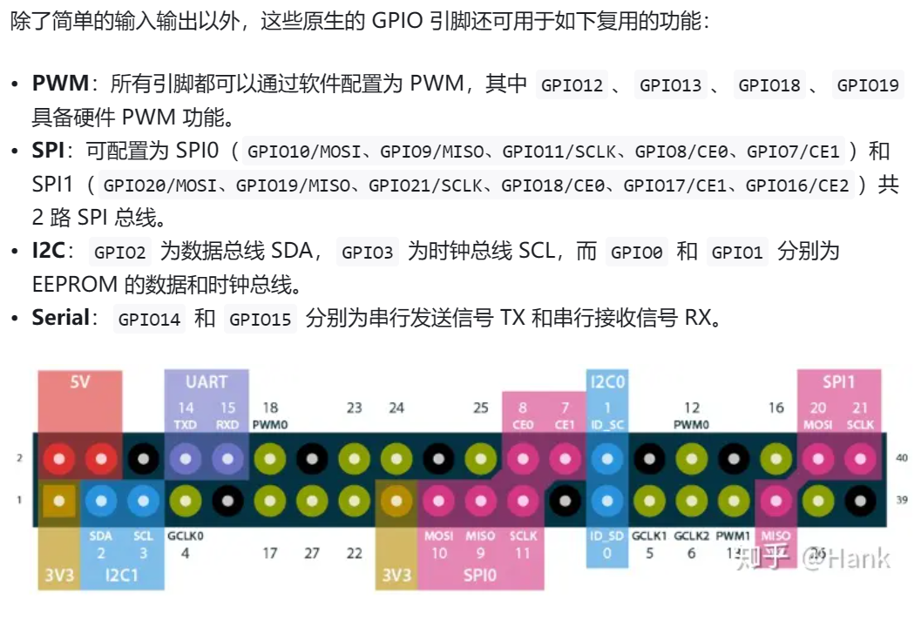
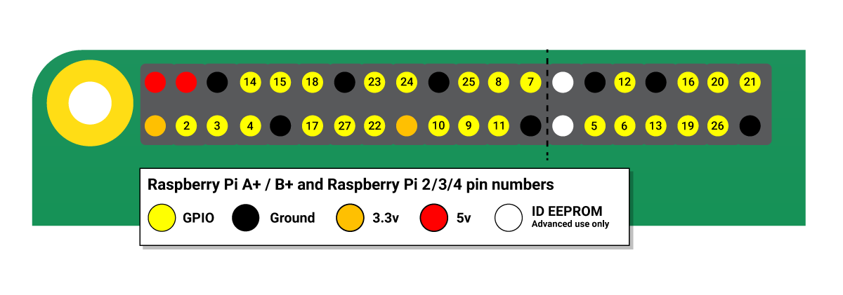
A.2.5 Raspberry Pi 4B
型号：4B
电压：Type C (5V 3A)
淘宝链接
树莓派GPIO
教程参考

Slide 43
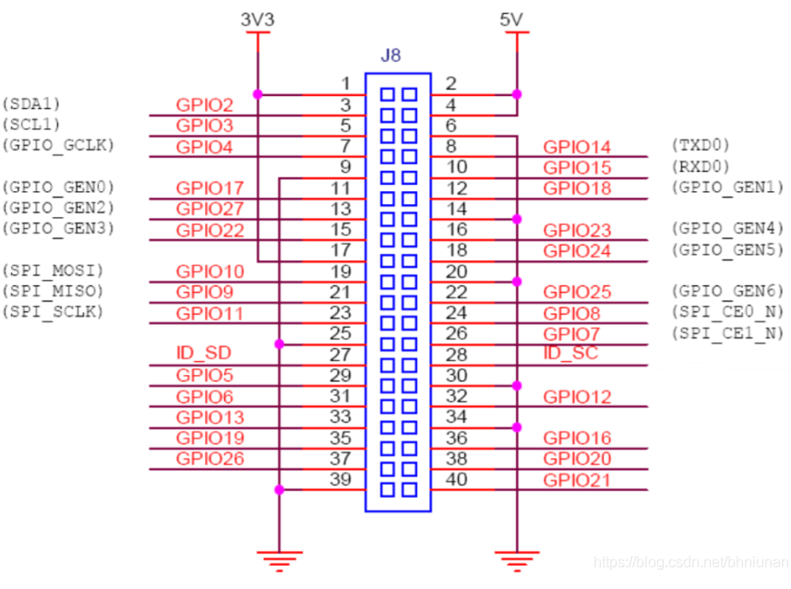
A.2.5 Raspberry Pi 4B

Slide 44
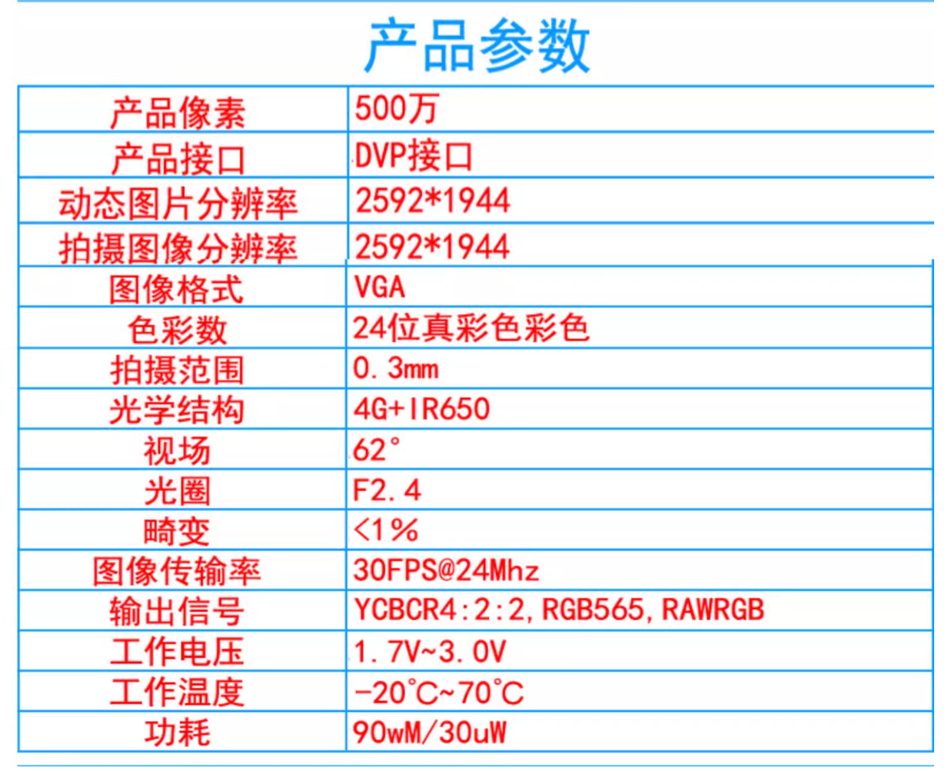
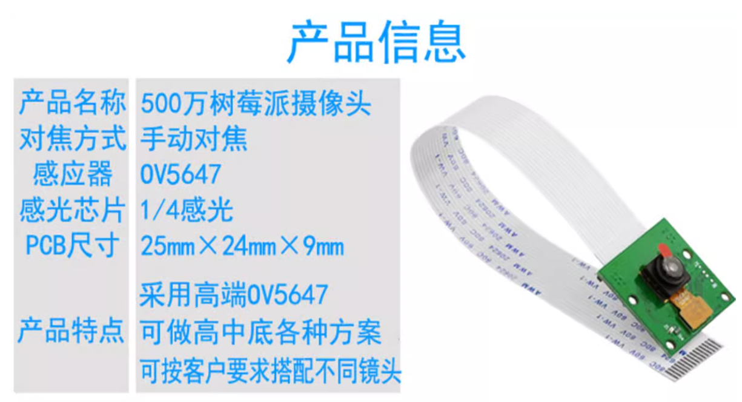
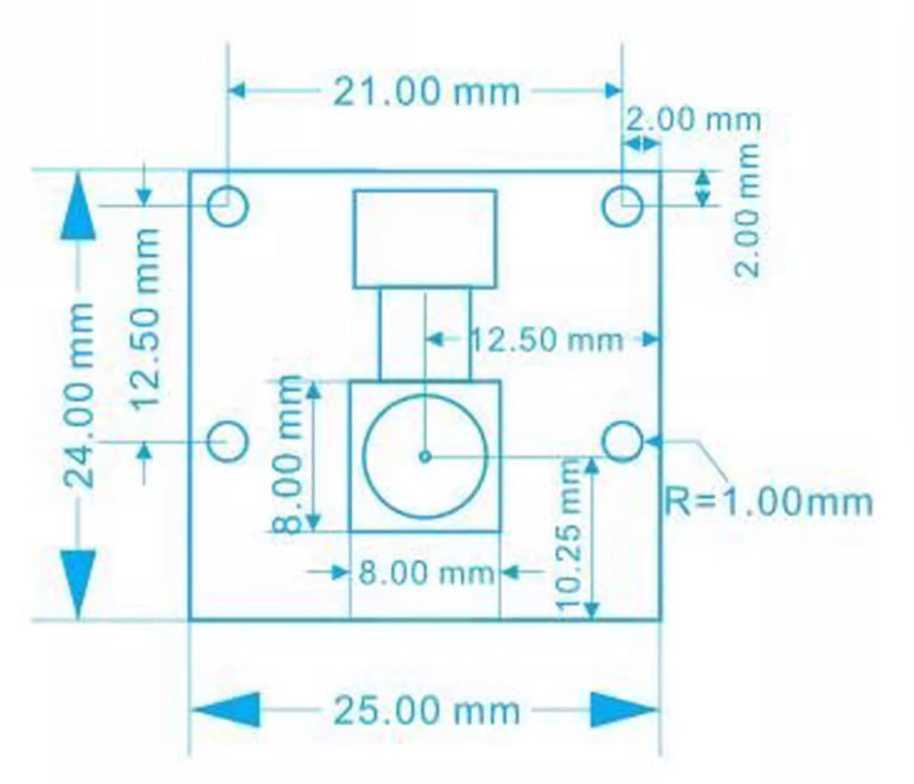
A.2.5.1 Raspberry Pi 4B Camera

Slide 45
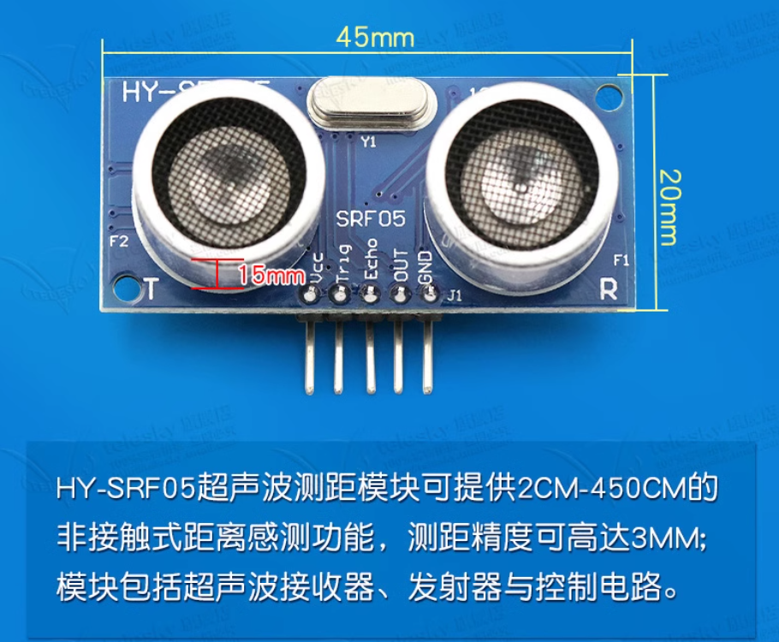
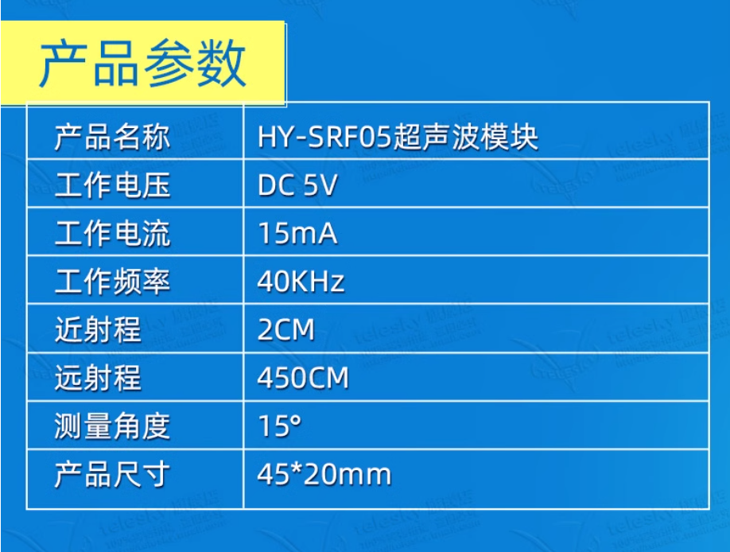
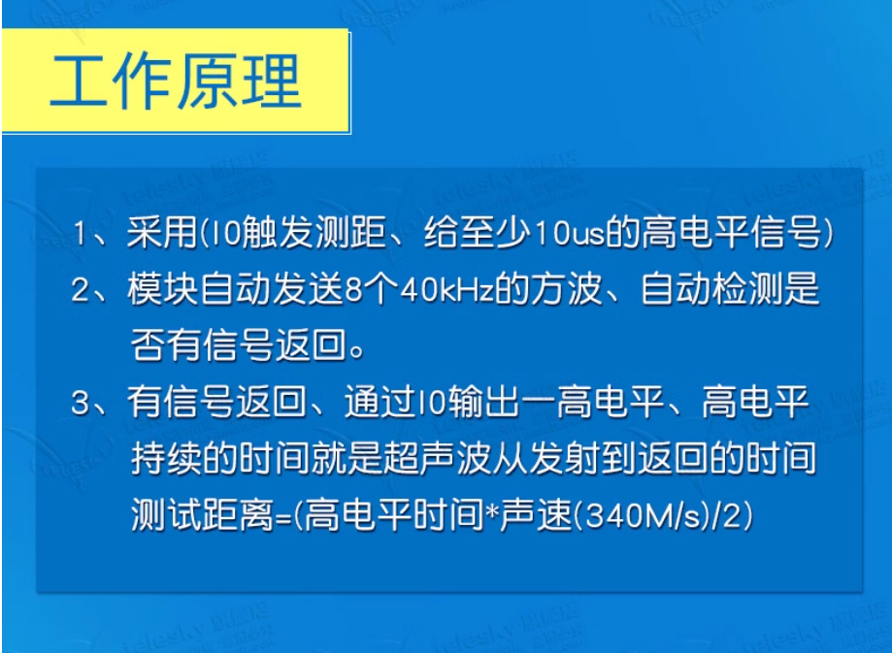
A.2.6 Ultrasonic
型号：HY-SRF05
电压：DC 5V
淘宝链接

Slide 46
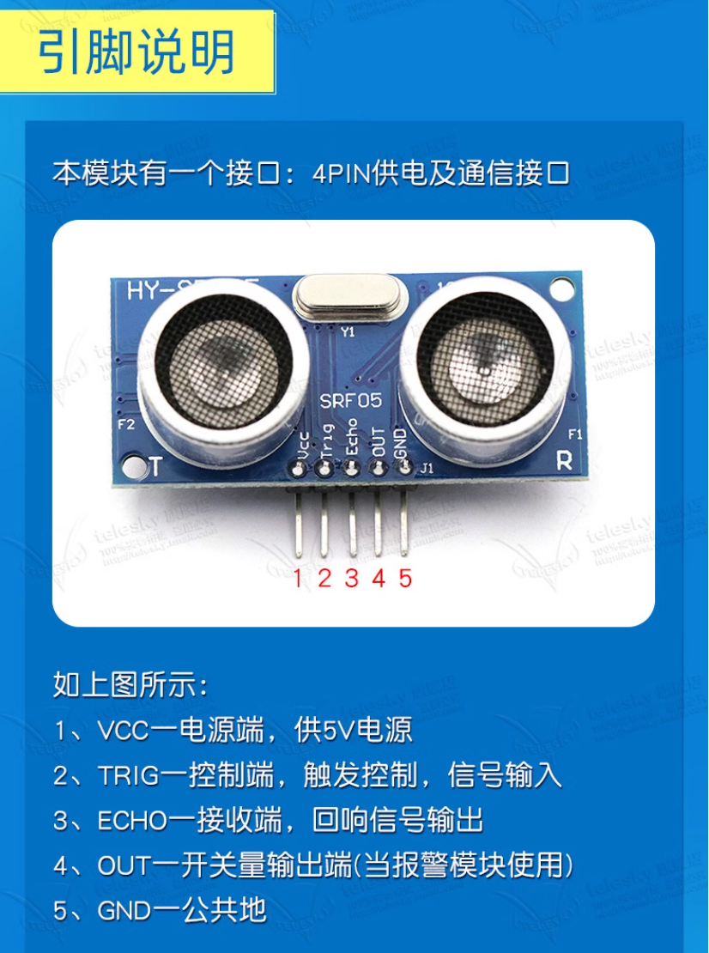
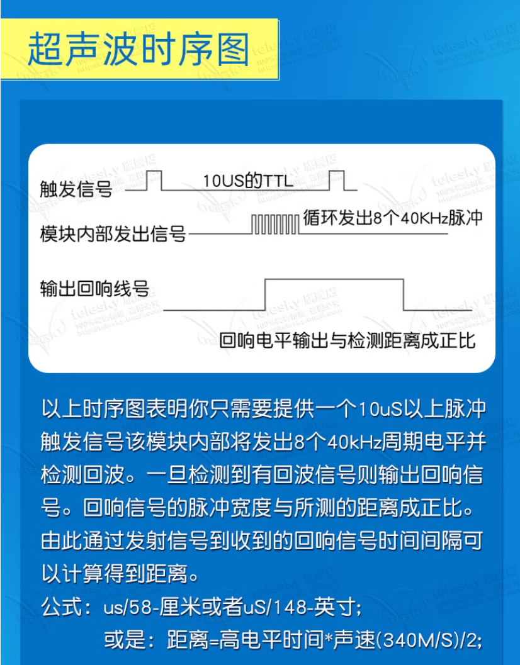
A.2.6 Ultrasonic
ECHO：0~VCC

Slide 47
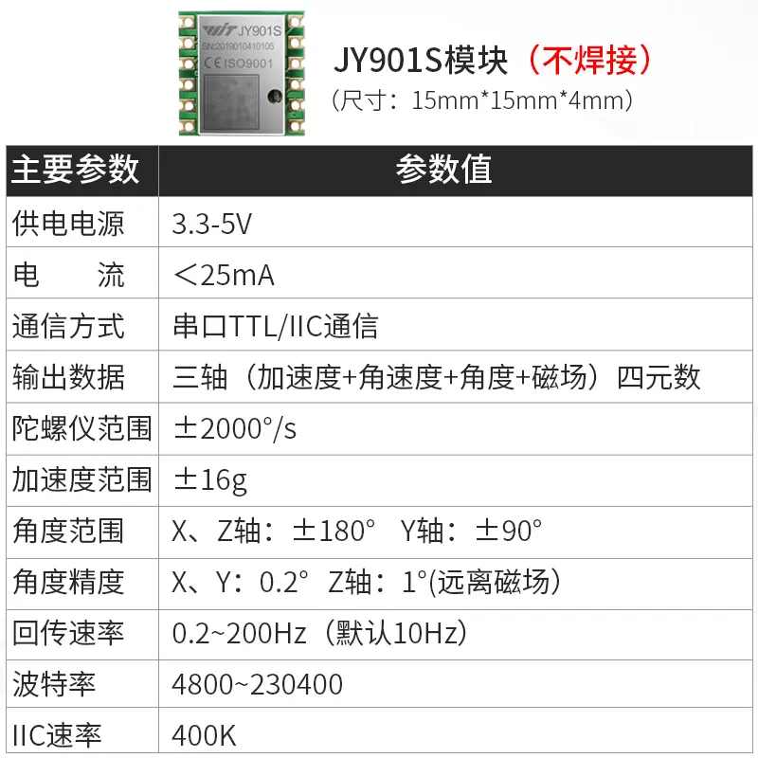
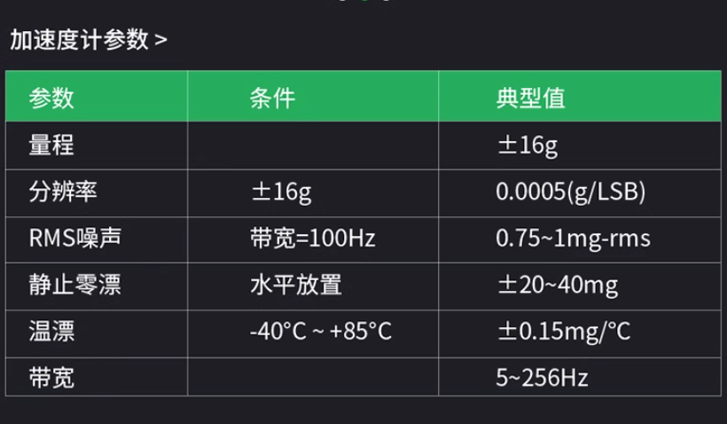
A.2.7 IMU
型号：JY901S
电压：DC 3.3~5V (默认：5V)
淘宝链接

Slide 48
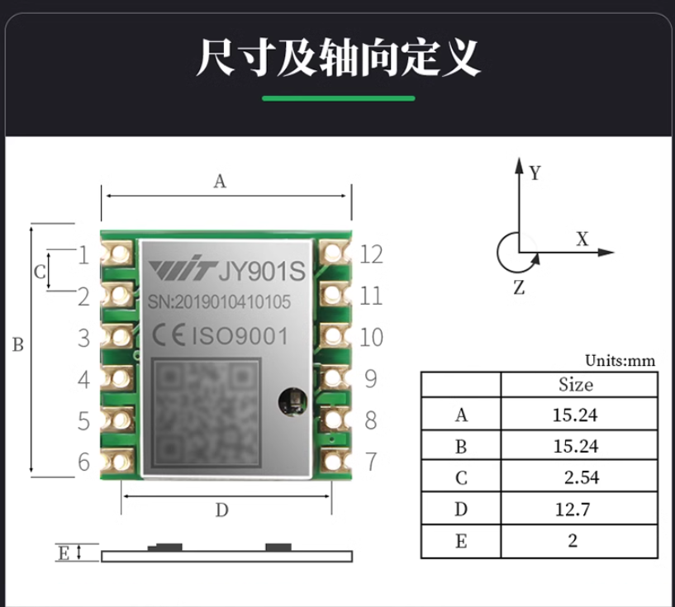
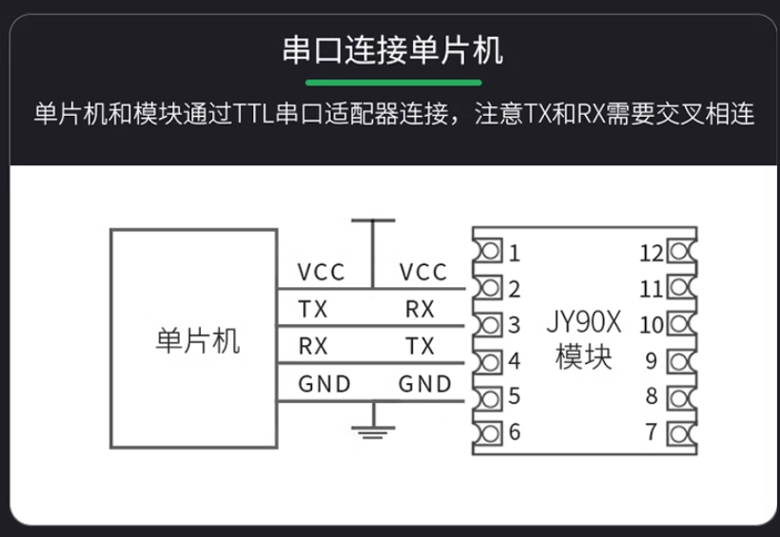
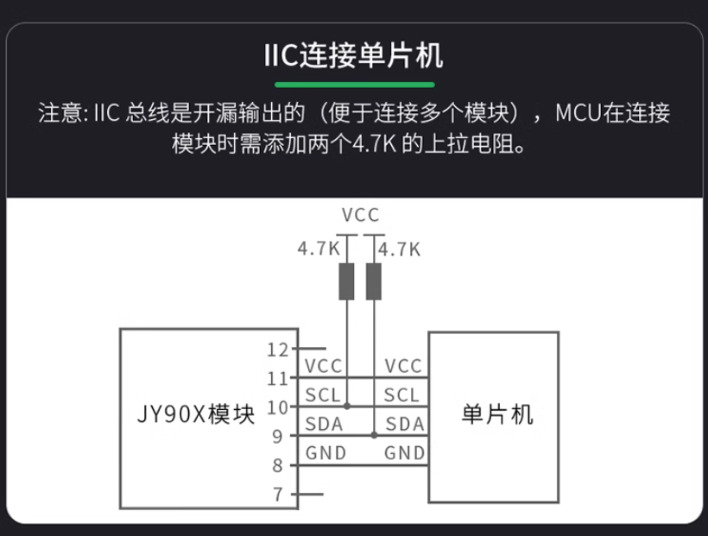
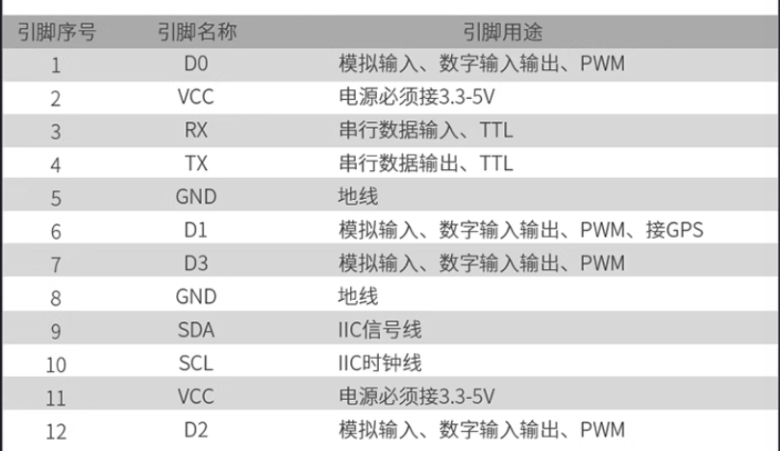
A.2.7 IMU

Slide 49
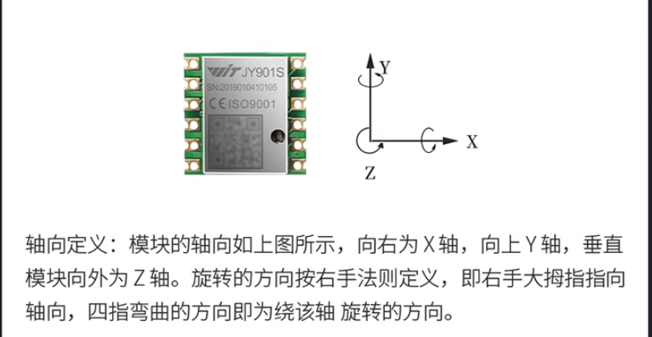
A.2.7 IMU

Slide 50
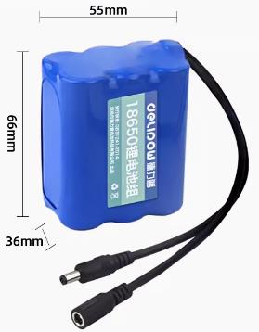
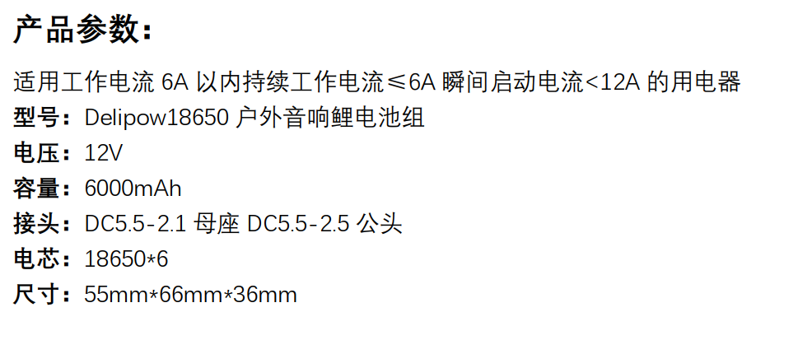
A.2.8 Battery
型号：18650
电压：DC 12V
容量：6000mAh
淘宝链接

Slide 51
A.3 Technical Documentations

Slide 52
A.3.1 Electrical System Schematic
移动电源5V
超声传感器1
HY-SRF05
直流电机左
25GA370
电机驱动模块
L298N
STM32F103VET6
Raspberry Pi
4 Model B
直流电机右
25GA370
电机驱动模块
L298N
直流电机
-旋转刷
加速度传感器
JY901S
舵机
SG90
电源模块LM2596
超声传感器2
HY-SRF05
12V电源

Slide 53
A.3.1 Electrical System Schematic
5V
HY-SRF05
TRIG
ECHO
25GA370
VCC
GND
Type-C
M2
GND
A
B
3V3
M1
OUT4
ENB
GPIO (PWM) PA8
OUT3
L298N
STM32F103
Pi 4B
IN4
GPIO PE12
GPIO PA3
Type-C
IN3
GPIO PE13
IN2
GPIO PE14
GPIO PC8
IN1
GPIO PE15
ENA
GPIO (PWM) PA9
OUT1
GND
GPIO (PWM) PA10
OUT2
12V
GPIO PE8
25GA370
GPIO PE9
GND
GPIO PA0
A
GPIO PA1
B
GPIO PA6
PB11 RX
TX GPIO 14
3V3
GPIO PA7
PB10 TX
RX GPIO 15
M1
M2
GPIO PB6
GPIO 2 (SDA)
GPIO PB7
GPIO 3 (SCL)
L298N
GPIO (PWM) PC6
GPIO PC7
IN2
GPIO PA2
IN1
TT
ENA
GND
OUT1
GND
GND
OUT2
12V
3V3
A
B
3V3
M1
M2
JY901S
SCL
VCC
SDA
GND
SG90
PWM
VCC
GND
LM2596
5V
3V3
GND
GND
HY-SRF05
VCC
GND
TRIG
ECHO
－
＋
12V
－
＋

Slide 54
A.3.2 Electrical Wiring Table
主控硬件引脚 | 引脚定义 | 元器件 | 元器件引脚
PA8 | TIM1_CH1 | L298N (1) | ENA
PE12 | IO |  | IN1
PE13 | IO |  | IN2
PA9 | TIM1_CH2 |  | ENB
PE14 | IO |  | IN3
PE15 | IO |  | IN4
PA10 | TIM1_CH3 | L298N (2) | ENA
PE8 | IO |  | IN1
PE9 | IO |  | IN2
PA0 | TIM5_CH1 | 25GA370 (1) | Encoder A phase
PA1 | TIM5_CH2 | 25GA370 (1) | Encoder B phase
PA6 | TIM3_CH1 | 25GA370 (2) | Encoder A phase
PA7 | TIM3_CH2 | 25GA370 (2) | Encoder B phase
PB6 | TIM4_CH1 | TT motor | Encoder A phase
PB7 | TIM4_CH2 | TT motor | Encoder B phase

Slide 55
A.3.2 Electrical Wiring Table
主控硬件引脚 | 引脚定义 | 元器件 | 元器件引脚
PC6 | TIM8_CH1 | SG90 | PWM
GND | / | LM2596 | GND
VIN | 5V input | LM2596 | 5V
PC7 | TIM8_CH2 | HY-SRF05 (1) | ECHO
PA2 | TIM2_CH3 |  | TRIG
PC8 | TIM8_CH3 | HY-SRF05 (2) | ECHO
PA3 | TIM2_CH4 |  | TRIG
PB11 | USART3_RX | Raspberry Pi 4 Model B | 8 (GPIO 14 TXD)
PB10 | USART3_TX |  | 10 (GPIO 15 RXD)
Above: STM32F103VET6
Below: Raspberry Pi 4 Model B
3 | GPIO 2 (SDA) | JY901S | SDA
5 | GPIO 3 (SCL) | JY901S | SCL
Type-C | / | Battery | Type-C

Slide 56
A.3.2 Electrical Wiring Table
元器件 | 元器件引脚 | 元器件 | 元器件引脚
L298N (1) | OUT1 | 25GA370 (1) | M1
L298N (1) | OUT2 | 25GA370 (1) | M2
L298N (1) | OUT3 | 25GA370 (2) | M1
L298N (1) | OUT4 | 25GA370 (2) | M2
L298N (2) | OUT1 | TT motor | M1
L298N (2) | OUT2 | TT motor | M2
Above: motor driver
Below: power supply
STM32F103VET6 | 3V3 | LM2596 | 3V3
TT motor
25GA370 (1)
25GA370 (2)
HY-SRF05 (1) | 5V |  | 5V
HY-SRF05 (2)
JY901S

Slide 57
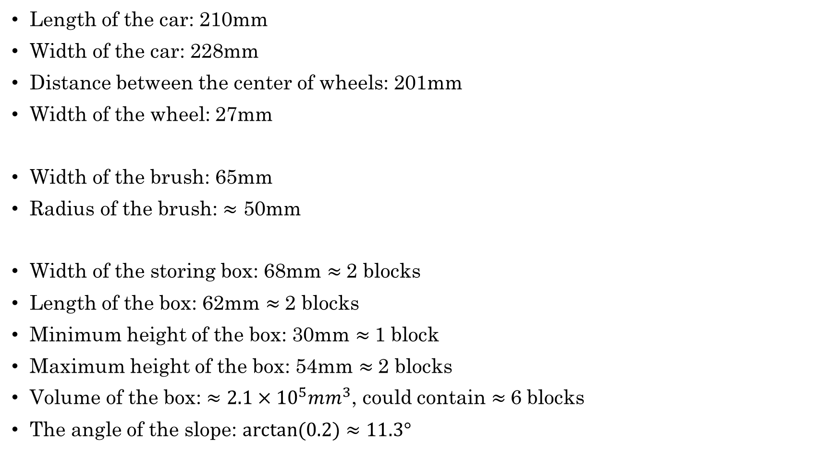
A.3.3 Parameters of the car
Length of the car: 210mm
Width of the car: 228mm
Distance between the center of wheels: 201mm
Width of the wheel: 27mm
Width of the brush: 65mm
Radius of the brush: $≈$ 50mm
Width of the storing box: 68mm $≈$2 blocks
Length of the box: 62mm $≈$2 blocks
Minimum height of the box: 30mm $≈$1 block
Maximum height of the box: 54mm $≈$2 blocks
Volume of the box: $≈2.1×{10}^{5}mm^{3}$, could contain $≈$6 blocks
The angle of the slope: $arctan⁡(0.2)≈11.3°$

